Slide 1
Bring Your Smart Module to Life

Slide 2
Agenda
Solution Overview
Essential Steps
System design
System installation
Online system configuration
Commissioning process & Smart Asset Management overview
Summary
Notes:
This presentation has 4 chapters, each can be presented individually as it’s own presentation.

Slide 3
Agenda
Solution Overview
Essential Steps
System design
System installation
Online system configuration
Commissioning process & Smart Asset Management overview
Summary
Notes:
This presentation has 4 chapters, each can be presented individually as it’s own presentation.

Slide 4
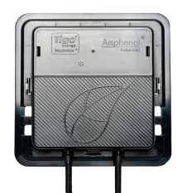
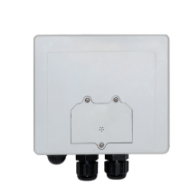
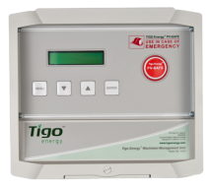
Tigo Solution as Easy as: 1 2 3
1 Smart Module
Power management and
communication
2 Gateway
Transmits data to Management Unit
3 Management Unit
Communication hub to
the cloud

Slide 5
Solution Overview
1 Smart Module
A PV Module that incorporates the Tigo Energy optimizer hardware into the junction box

Slide 6
Solution Overview
2 Gateway
Radio transceiver that communicates with optimizers and relays data to the Management Unit

Slide 7
Solution Overview
3 Management Unit
Computer that controls the system and transmits system data to the internet
Used as a data-logger for 3rd party devices

Slide 8
Tigo System
Notes:
- Smart Modules are wired together just like standard PV Modules
- Smart Modules communicate wirelessly with the gateway
- Gateway transmits data via an RS-485 communication wire to the MMU
- The MMU controls the array with the gateway and uploads data to the internet.

Slide 9
Agenda
Solution Overview
Essential Steps
System design
System installation
Online system configuration
Commissioning process & Smart Asset Management overview
Summary
Notes:
This presentation has 4 chapters, each can be presented individually as it’s own presentation.

Slide 10
Agenda
Solution Overview
Essential Steps
System design
System installation
Online system configuration
Commissioning process & Smart Asset Management overview
Summary
Notes:
This presentation has 4 chapters, each can be presented individually as it’s own presentation.

Slide 11
Essential Steps
Design
Install
Commission
Design
Install
Commission

Slide 12
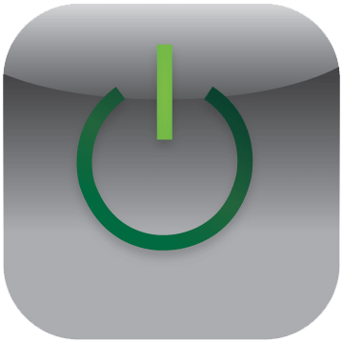
Solution Benefits: 1 2 3
1 Communication
2 More Energy
3 Longer Strings
Monitoring
Safety
Flexible Design
More Revenue
Lower BOS
Easy Operations

Slide 13
Design

Slide 14
Design
Design your smart module layout
Determine how many Gateways are required
Determine how many MMUs are required

Slide 15
1 Smart Module
Installed physically like a standard PV module
Works with any inverter
Design string sizing according to lower Voc
Enable uneven strings, design into shade, etc.

Slide 16
Pick Any Inverter
Works in any geography or system size
Operating in the field with over 2,000 inverter SKU’s from over 80 companies
Letters of compatibility and warranty exchanged with ALL Tier 1 inverter companies
Notes:
We are getting more inverter letters all the time. There are practically no major inverter manufacturers that haven’t given us a letter of approval. No other optimizer can say this.

Slide 17
String Sizing
Voc is limited in Smart Modules
No de-rating for cold temperature
Design to inverter MPPT window:
Traditional String Design:
Smart Modules String Design:
Notes:
All the parameters appear in the Smart Module’s datasheet.

Slide 18
String Sizing Example
Trinasmart 250W
Traditional 250W
Vmp = 30.3V
Voc = 32.5V
Temperature coefficient of Voc: +0%/°C , -0.32%/°C
Vmp = 30.3V
Voc (traditional) = 37.6
Temperature coefficient of Voc: ±0.32%/°C
Highest temperature recorded San Jose: 43°C
Coldest temperature recorded San Jose: -7°C
Who Does it Apply to My Design?

Slide 19
String Length Calculation
We’ll check the following 2 modules with a Fronius IG Plus for example
Inverter parameters:
Min Vmp = 230V
Max Vmp = 580V
Calculating minimum string length according to traditional way
Calculating maximum string length:
580V / 32.5V = 17 modules per string
See full comparison in the next slide

Slide 20
Results with Fronius IG Plus A
Trinasmart
Reduces the number of strings in 42% of the cases, saving labor, time and cost
Traditionally
Systems that require 15-17 / 29-34 / 40-45 panels will require an additional string and / or a design change

Slide 21
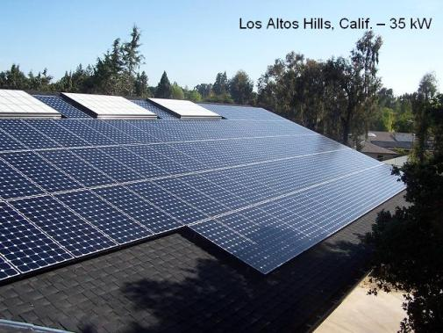
Layout
Design uneven strings in parallel
Design into shade with Setback ratio 50% smaller
Design on different orientation and pitches

Slide 22
Parallel Strings
Smart Modules enable up to 25% mismatch between strings
If 1 string has 16 modules in series, a parallel string can have up to the following:
16 * 0.75 = 12 modules in parallel
or
16 / 0.75 = 21 modules in parallel
Always design your strings so that the number of shorter strings exceeds the number of longer strings
Notes:
For the 16 example with 12, obviously it means 16 can be paired with 13, 14, and 15.
For the 16 example with 21, obviously it means 16 can be paired with 17, 18, 19, and 20.

Slide 23
Design in Shade
Set back ratios are defined according to object height : shadow length
The proper setback ratio is determined according to sun charts
Typical set back ratio (non-optimized) is 1:3
Studies show Smart Modules minimize the energy loss, so that 1:1.5 set back ratio with Smart Modules has the same losses as 1:3 set back ratio for traditional modules
Object Height
Shadow Length

Slide 24
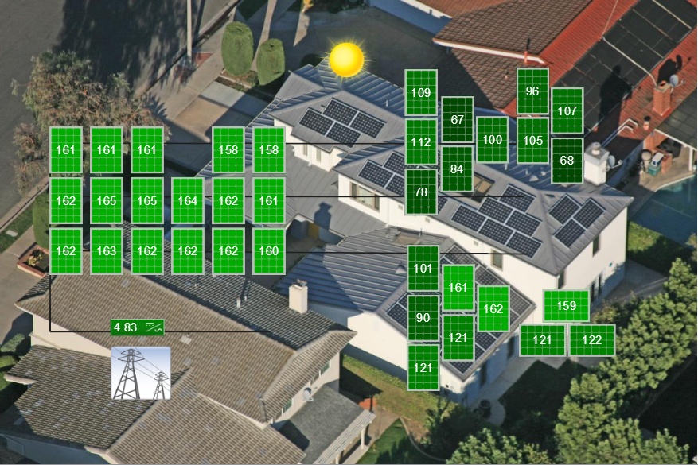
Different Orientations
You can have panels in the same string at different orientations
Smart Modules enable different pitches and azimuths, all in the same string
Minimum panels East / West orientation to have the inverter start up / running

Slide 25
2 Gateway
Each Gateway communicates with up to 120 PV Modules
50ft (15 m) line-of-sight wireless signal radius
Requires RS485 cable run to the Management Unit
Mounted on the panel frame or racking system
Wireless from gateway to Smart Modules

Slide 26
RS485 Cables
4 Conductor communication wire
Ethernet CAT 5 cable is suitable
All cable types must be:
UV resistant
Outdoor rated
Twisted pair
non-shielded
0.33mm² or lager conductors
Notes:
More cabling information available online

Slide 27
Gateway Layout
Place gateways to cover every module in the array
Each circle represents the 50ft (15m) signal radius of each gateway
Red circles are controlled by MMU1, blue controlled by MMU2

Slide 28
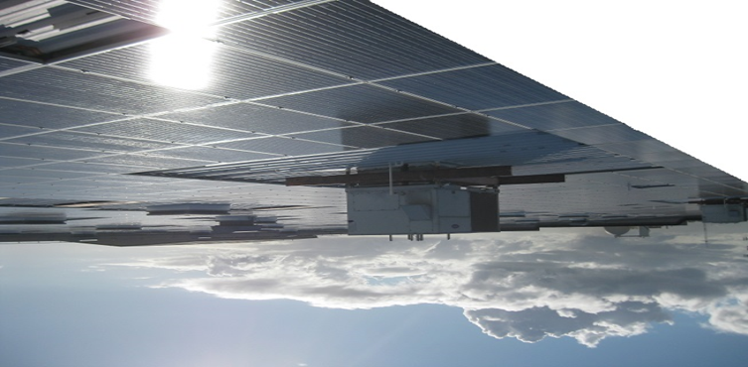
Gateway Layout: Obstacles
Wireless signals can be blocked by obstructions in the array
Add more gateways to provide complete coverage in case of obstacle presence
Panels mounted with metal shielding or very close to the roof can reduce wireless signal

Slide 29
Gateway Layout: Summary
Gateways can communicate with up to 120 panels
Up to 7 Gateways can be wired in series (Daisy-chained)
Each Gateway has Communication radius of 50ft (15m) line of sight
Click here for examples

Slide 30
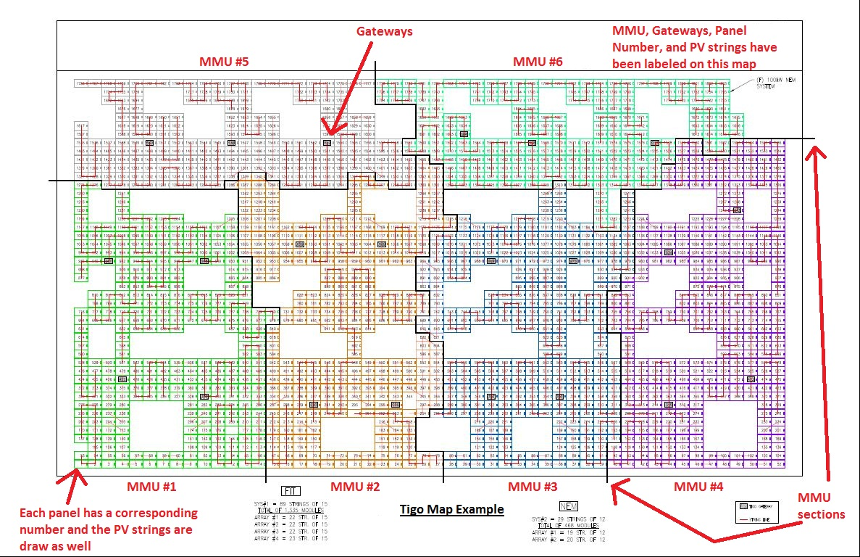
Example:
Commercial roof
1,803 panels
400kW system
6 MMUs
22 Gateways
Gateways spaced around obstructions

Slide 31
Example:
15 panels per string
Each panel is mapped to its physical installation
Each panel is labeled with a number 1 to 1,803
Panel number is used to organize maximizer serial number

Slide 32
3 Management Unit
Each Management Unit covers up to 360 PV Modules
Connects with up to 7 Gateways
Communicates with inverters, AC meters, weather stations etc.

Slide 33
Requirements
AC power outlet 100V to 240V 50-60 Hz
Internet Connection via CAT-5 Ethernet cable
4 Conductor RS-485 communication cable to the gateways
Install as many MMUs as needed to cover the entire PV array

Slide 34
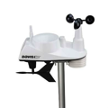
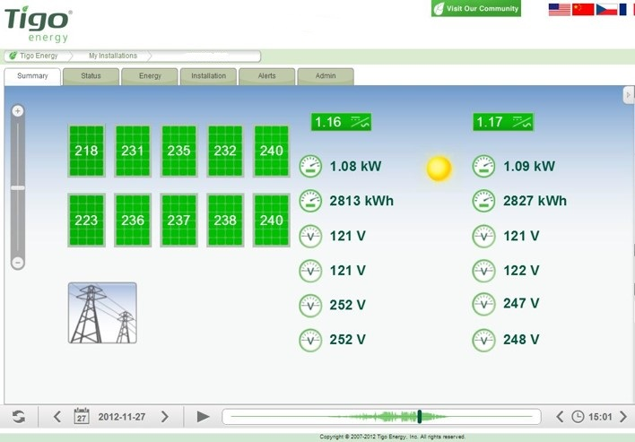
Accessories
MMU can read and report data from 3rd party AC Meters, inverters and weather stations via Modbus RS-485 connection
AC production data can be viewed on the Tigo website along with DC module level data

Slide 35
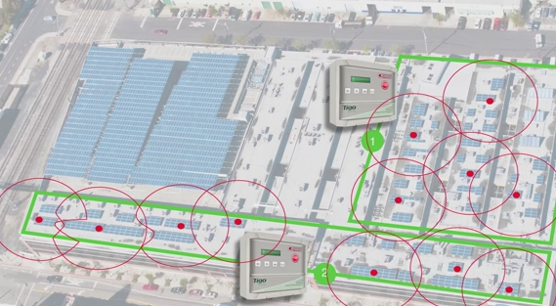
Design Summary
Smart Modules work with any inverter
Each Gateway handles:
120 modules
50ft (15m) radius minus obstacles
Each MMU handles:
360 modules
Up to 7 Gateways

Slide 36
Essential Steps
Design
Install
Commission
Design
Install
Commission

Slide 37
Install

Slide 38
Smart Install
Install Management Unit and Gateway
Install your Smart Modules and keep the barcodes
Configure the system online, and initiate discovery

Slide 39
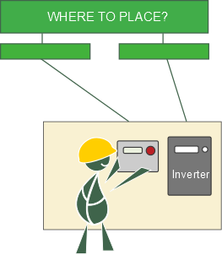
Install the MMU
Close to the inverter’s AC outlet
Next to an available Internet connection
Ethernet spot
WiFi (with an adapter)
PLC (with an adapter)
Cellular (with an adapter)
Place on wall or beam next to the inverter
Wall or Beam
Near Inverter
Notes:
MMU: Management Unit
Adapters are not provided by Tigo Energy and can bought off-shelf from any 3rd party.

Slide 40
Install the MMU
3 Connections:

Slide 41
Install the MMU
3 Connections:
3 Connections
1. Internet

Slide 42
Install the MMU
3 Connections:
2. Power

Slide 43
Install the MMU
3 Connections:
3. Gateway

Slide 44
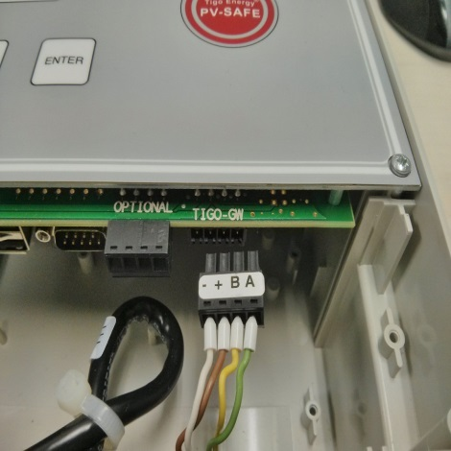
Install the MMU
3 Connections:
3. Gateway
Terminal blocks can be removed
Notes:
Removing the terminals makes the RS485 wiring much easier.
Remember to pull the wire through the gland.

Slide 45
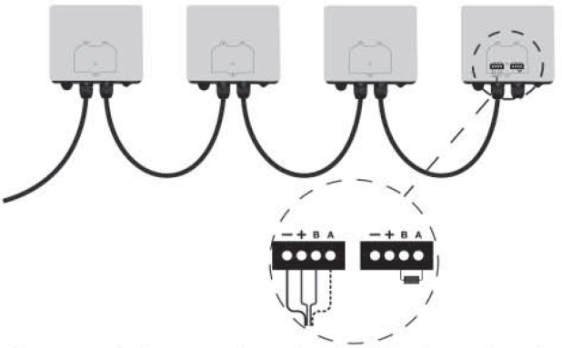
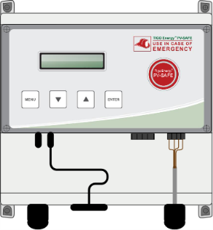
Install the Gateway
Locate the location of the Gateway in the site map, near the physical center of the array
Mount the Gateways either to the frame of the module or racking system
Run communication cable from the MMU to the Gateways in series

Slide 46
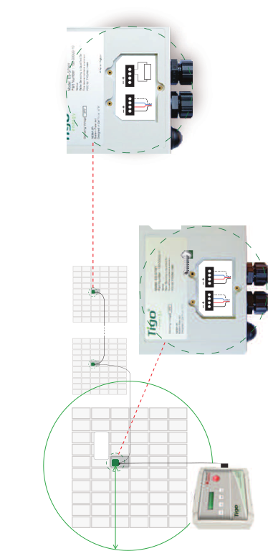
Install the Gateway
Mount in the middle of the array
according to the site map
50ft (15m)

Slide 47
Install the Gateway
Run cable from MMU to all Gateways
Last Gateway
should have the
resistor connected
Notes:
120 Ohm resistor, comes in each GW and should be removed in all GWs but the last one in the chain

Slide 48
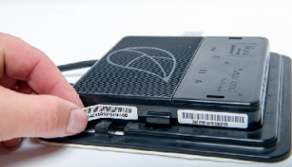
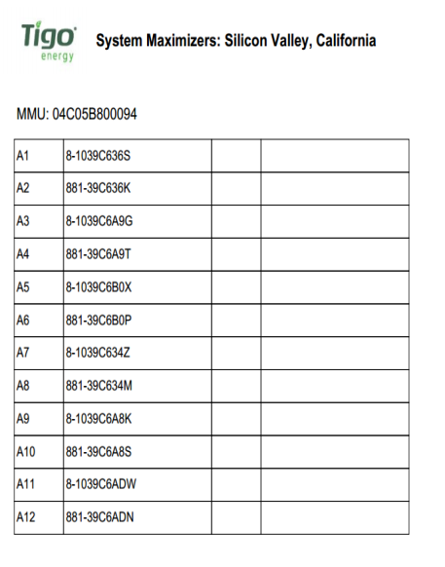
Install the Smart Modules
Before placing the modules, remove the peel able barcode sticker and place on array layout or string list
Notes:
Especially important in residential, where after you placed the module it is hard to reach the sticker.
In ground mount systems where the back of the panels is accessible it is possible to leave the stickers and scan the barcodes directly from the Jbox to an excel sheet, marking position with A1, A2, A3…

Slide 49
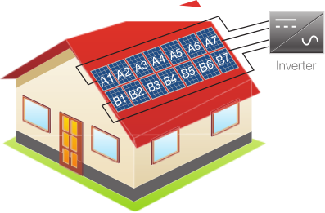
Install the Smart Modules
Mount and connect as is if the Smart Modules are standard modules, according to the site map or string list
Notes:
Especially important in residential, where after you placed the module it is hard to reach the sticker.
In ground mount systems where the back of the panels is accessible it is possible to leave the stickers and scan the barcodes directly from the Jbox to an excel sheet, marking position with A1, A2, A3…

Slide 50
Time Estimation: Installation
MMU (10 – 30 minutes) per unit
Gateways (5 – 10 minutes) per unit
Smart modules (1 second) per module
Remove MAC ID sticker
Note: Installation times are given as approximations
Notes:
Installation time may vary depending on project size, site characteristics, weather conditions, installation skill, and other unpredictable circumstances.

Slide 51
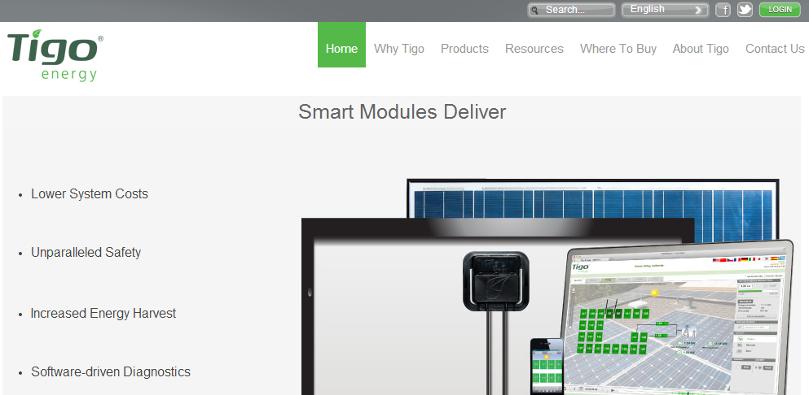
Configure the System
Go to www.tigoenergy.com/ and press “Login”
Have your site map or string list with barcodes

Slide 52
Configure the System
Use a barcode scanner to save time
Easy to use, simply plug and play
Notes:
Installation wizard will guide you through your online configuration.
For that part you will need your site map or string list with barcodes collected.

Slide 53
Configure the System
Log in

Slide 54
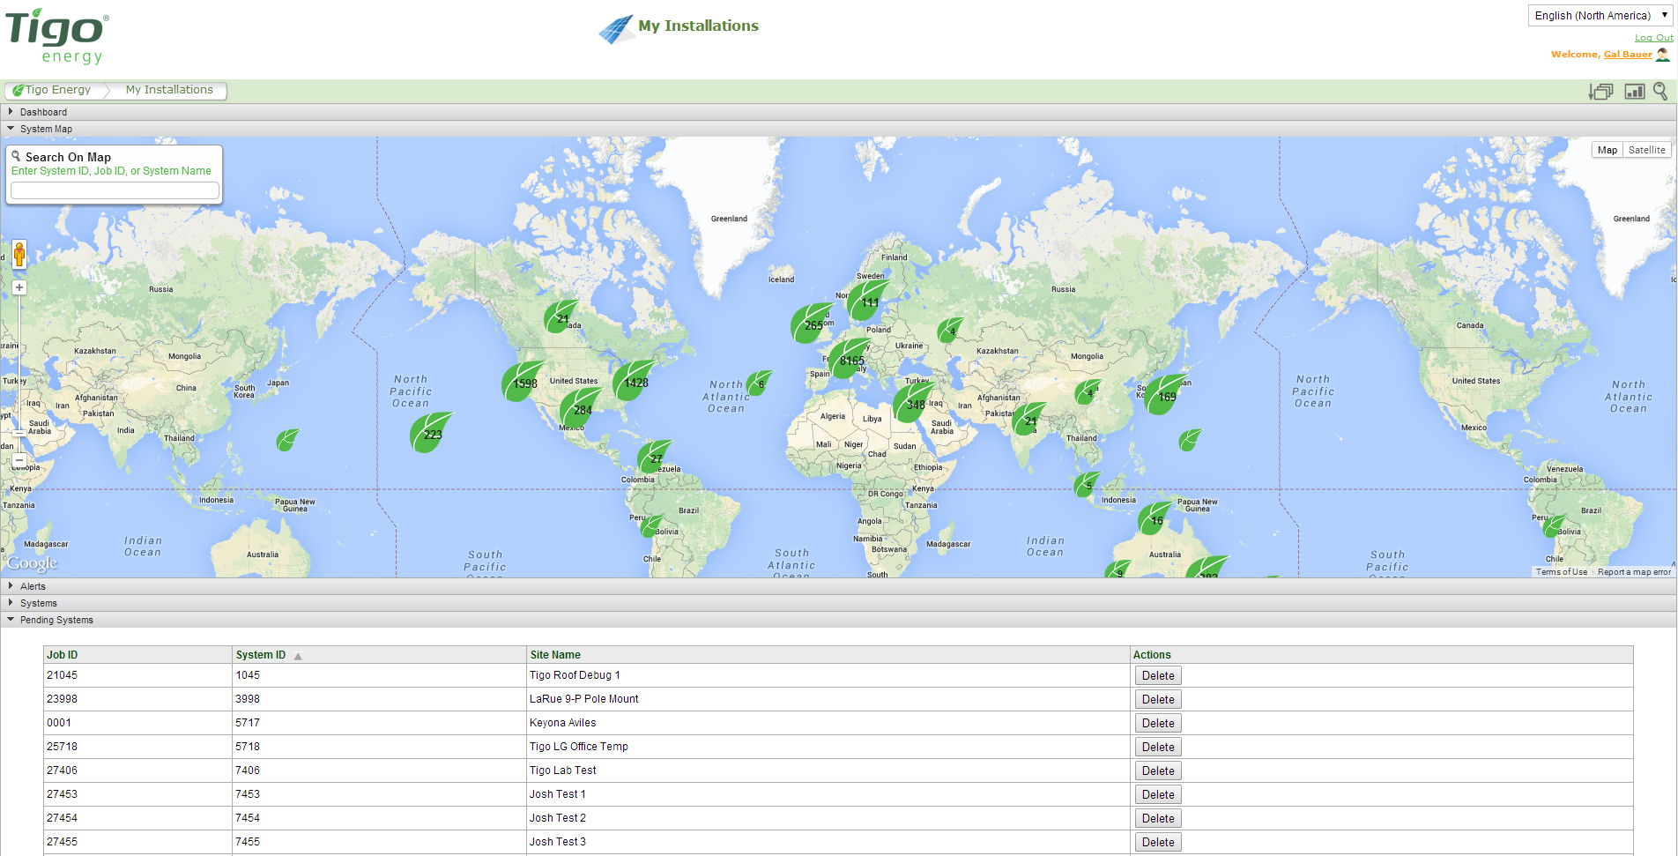
Configure the System
Click on “New Installation” at the bottom
Notes:
Installation wizard will guide you through your online configuration.
For that part you will need your site map or string list with barcodes collected.

Slide 55
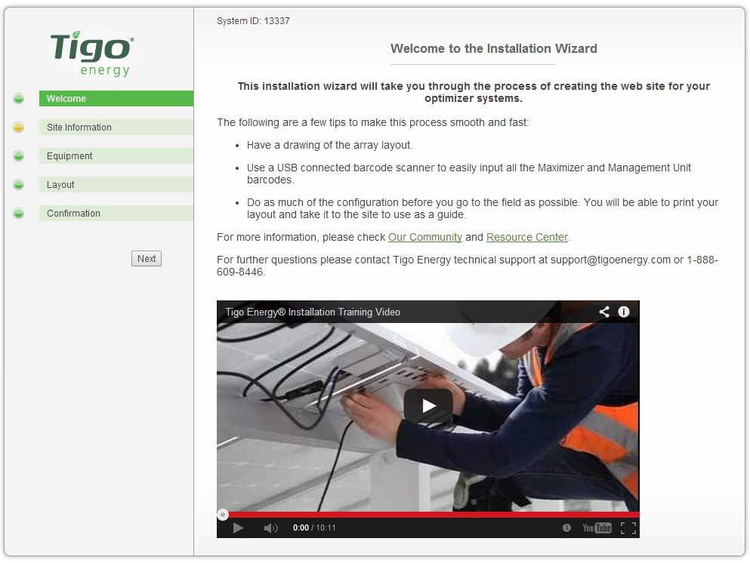
Configure the System
Follow the instructions of the installation wizard
Notes:
Installation wizard will guide you through your online configuration.
For that part you will need your site map or string list with barcodes collected.

Slide 56
Configure the System
Follow the instructions of the installation wizard
For a detailed walk through press here
Notes:
Installation wizard will guide you through your online configuration.
For that part you will need your site map or string list with barcodes collected.

Slide 57
Configure the System
Enter site information:
Address
Site owner information
3rd party finance, if such exists
Click Next

Slide 58
Configure the System
Enter inverter information

Slide 59
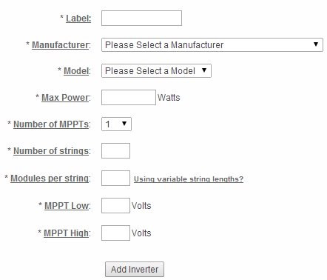
Configure the System
Enter inverter information

Slide 60
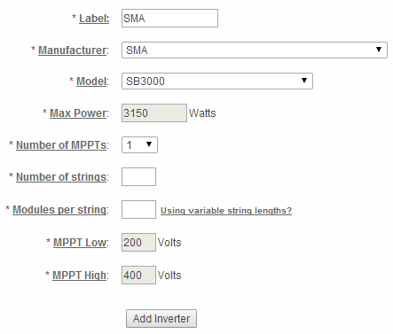
Configure the System
Enter inverter information
After choosing model the following will auto-fill

Slide 61
Configure the System
Enter string information per chosen inverter

Slide 62
Configure the System
Enter string information per chosen inverter
If you’re strings are uneven press

Slide 63
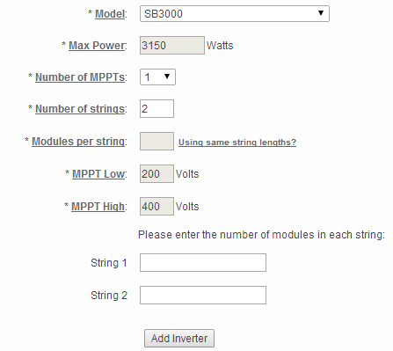
Configure the System
Enter string information per chosen inverter
If you’re strings are uneven press

Slide 64
Configure the System
And fill the number of modules per string

Slide 65
Configure the System
If you’re using more than 1 inverter type, click “Add inverter” to add another one

Slide 66
Configure the System
Once done scroll down to Module section

Slide 67
Configure the System
Enter PV module information

Slide 68
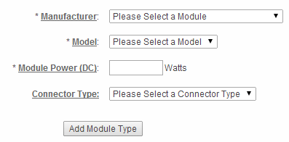
Configure the System
Enter PV module information

Slide 69
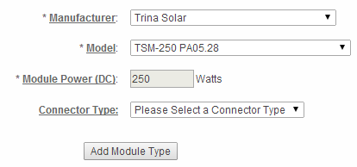
Configure the System
Enter PV module information
After choosing model the following will auto-fill

Slide 70
Configure the System
Select connector type

Slide 71
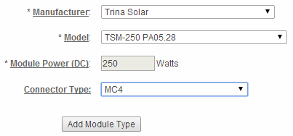
Configure the System
If using more than 1 PV module types, press ‘Add Module Type’

Slide 72
Configure the System
Once down scroll down to Management Unit section

Slide 73
Configure the System
Enter Management Unit information

Slide 74
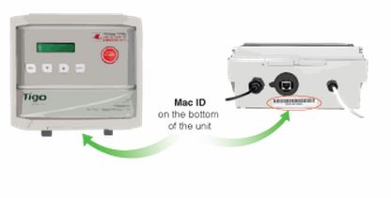
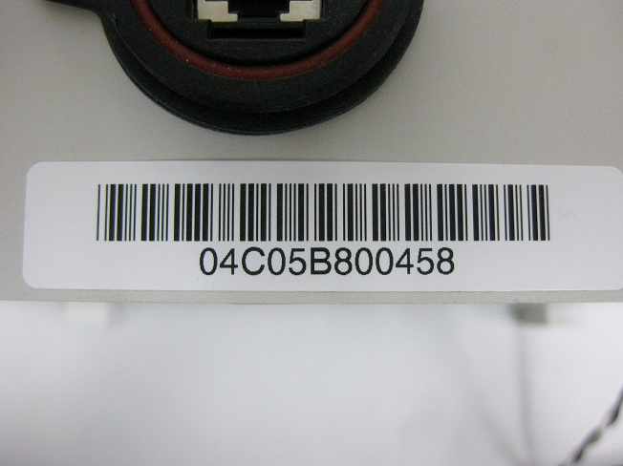
Configure the System
Tigo MMUs have 12 digit MAC IDs
Located on the bottom of the MMU
You can use your barcode scanner to insert the MAC ID
Notes:
Installation wizard will guide you through your online configuration.
For that part you will need your site map or string list with barcodes collected.

Slide 75
Configure the System
Once done, scroll back up and click ‘Next’ on the left

Slide 76
Configure the System
Keep on your maps the Gateway’s MAC ID:
Tigo MMUs have 16 digit MAC IDs
Located on the on housing of gateway

Slide 77
Configure the System
Enter layout information

Slide 78
Configure the System
Click the grid to begin placing the modules as they appear on the roof

Slide 79
Configure the System
Click the grid to begin placing the modules as they appear on the roof
Use the bottom part to choose how to place the modules

Slide 80
Configure the System
You can place the module in portrait or landscape

Slide 81
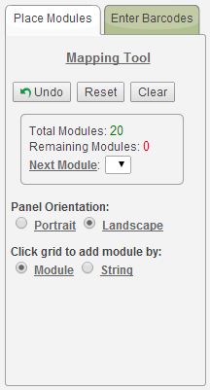
Configure the System
You can choose to place a single module per click, or a string at a click

Slide 82
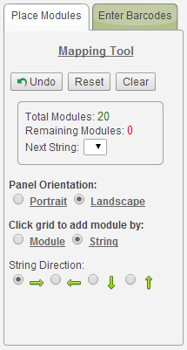
Configure the System
If you choose a string you’ll get to choose the direction in which the modules will be placed

Slide 83
Configure the System
Once done with the physical layout it’s time to upload the barcodes
Notes:
Installation wizard will guide you through your online configuration.
For that part you will need your site map or string list with barcodes collected.

Slide 84
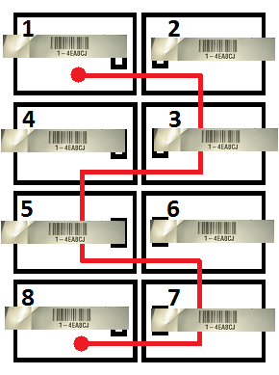
Configure the System
Map with barcodes from the installation site should show how the panels are wired
Notes:
Installation wizard will guide you through your online configuration.
For that part you will need your site map or string list with barcodes collected.

Slide 85
Configure the System
There are 2 ways to enter the barcodes:
Notes:
Installation wizard will guide you through your online configuration.
For that part you will need your site map or string list with barcodes collected.

Slide 86
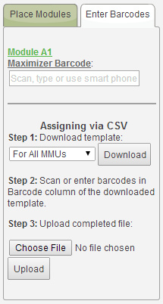
Configure the System
There are 2 ways to enter the barcodes:
By scanning or typing the barcodes in the upper section based on the map
Notes:
Installation wizard will guide you through your online configuration.
For that part you will need your site map or string list with barcodes collected.

Slide 87
Configure the System
There are 2 ways to enter the barcodes:
By downloading a template, scanning barcodes into it while on site and later uploading it
Notes:
Installation wizard will guide you through your online configuration.
For that part you will need your site map or string list with barcodes collected.

Slide 88
Configure the System
Once done uploading the barcodes you’ll see the modules have all turned green
Notes:
Installation wizard will guide you through your online configuration.
For that part you will need your site map or string list with barcodes collected.

Slide 89
Configure the System
Press next
Notes:
Installation wizard will guide you through your online configuration.
For that part you will need your site map or string list with barcodes collected.

Slide 90
Configure the System
Review summary and confirm
Notes:
Installation wizard will guide you through your online configuration.
For that part you will need your site map or string list with barcodes collected.

Slide 91
Configure the System
You can download a map of your system
Notes:
Installation wizard will guide you through your online configuration.
For that part you will need your site map or string list with barcodes collected.

Slide 92
Configure the System
You can download a map of your system
Notes:
Installation wizard will guide you through your online configuration.
For that part you will need your site map or string list with barcodes collected.

Slide 93
Configure the System
And a table referencing of your map and barcodes
Notes:
Installation wizard will guide you through your online configuration.
For that part you will need your site map or string list with barcodes collected.

Slide 94
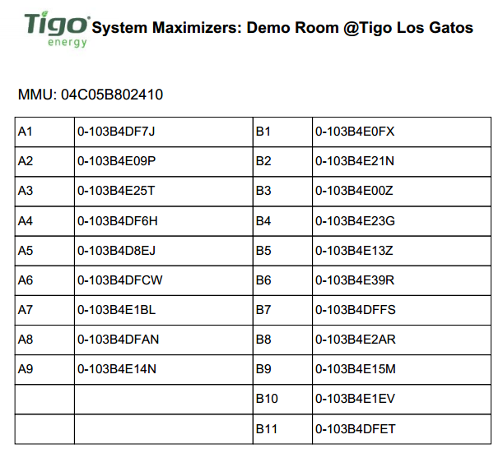
Configure the System
And a table referencing of your map and barcodes
Notes:
Installation wizard will guide you through your online configuration.
For that part you will need your site map or string list with barcodes collected.

Slide 95
Configure the System
Once done, press Finish
Notes:
Installation wizard will guide you through your online configuration.
For that part you will need your site map or string list with barcodes collected.

Slide 96
Configure the System
And – You’re Done!
Notes:
Installation wizard will guide you through your online configuration.
For that part you will need your site map or string list with barcodes collected.

Slide 97
Time Estimation: Configuration
Organizational time (dependent on user and system)
Entering basic system information (10 – 15 minutes)
System mapping (0.5 – 3 seconds) per panel
Entering MAC IDs (0.5 – 2 seconds) per panel
Note: Configuration times are given as approximations
Notes:
Configuration time may vary depending on project size, site characteristics, installation skill, and other unpredictable circumstances.

Slide 98
Essential Steps
Design
Install
Commission
Design
Install
Commission

Slide 99
Commission

Slide 100
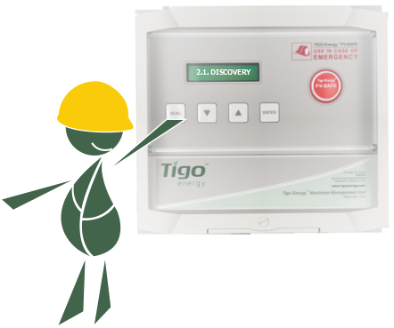
Run Tests
Press “Network Test” on the MMU
Press “Gateway Test” on the MMU
Notes:
Discovery process is meant for MMU to locate all the optimizers that were assigned to it.

Slide 101
Initiate Discovery
Press “Discovery” on the MMU
Notes:
Discovery process is meant for MMU to locate all the optimizers that were assigned to it.

Slide 102
Initiate Discovery
Press “Discovery” on the MMU
Note: Online configuration must be completed before discovery is run
Notes:
Depending on system size it may take a few hours for all Maximizers to complete discovery.

Slide 103
Initiate Discovery
Wait for MMU to confirm all modules were found
Notes:
Depending on system size it may take a few hours for all Maximizers to complete discovery.

Slide 104
Double Check
Do not leave the site without:
Discovering all modules
Checking String voltage
Finalizing inverter commissioning
Turn off the inverter?

Slide 105
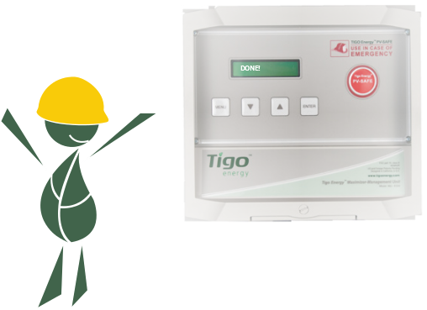
And – On Site is Done!

Slide 106
Time Estimation: Discovery
Large systems 250kW or greater (1 – 3 hours) per MMU
Discovery can be run on multiple MMUs at once
Small systems 30kW or less (5 – 30 minutes) per MMU
Note: Discovery times are given as approximations
Notes:
Configuration time may vary depending on project size, site characteristics, installation skill, and other unpredictable circumstances.

Slide 107
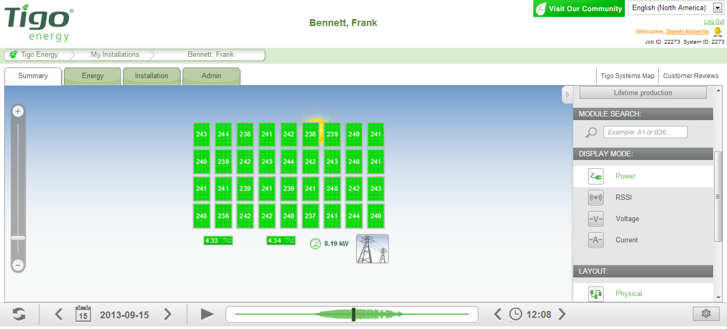
Commission Smart
Use Tigo Energy’s summary page and check each and every module’s
Power
Current
Voltage

Slide 108
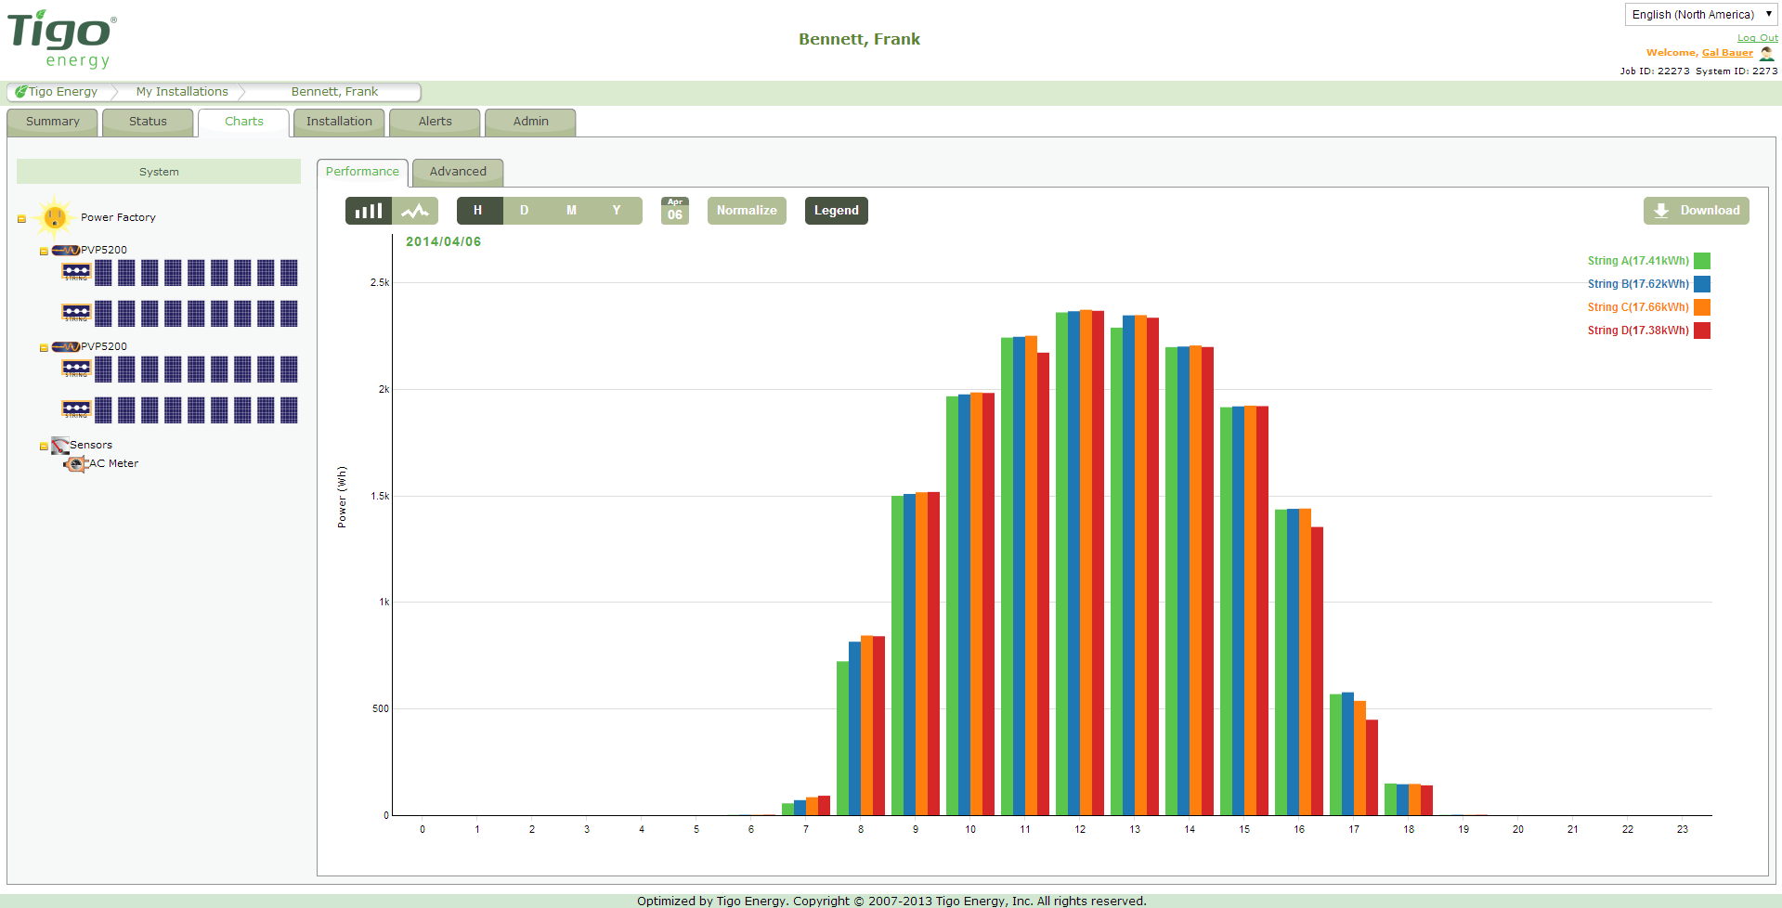
Commission Smart
Use Tigo Energy’s energy tab to evaluate array production over time and to compare system components
Modules
Strings
Inverters

Slide 109
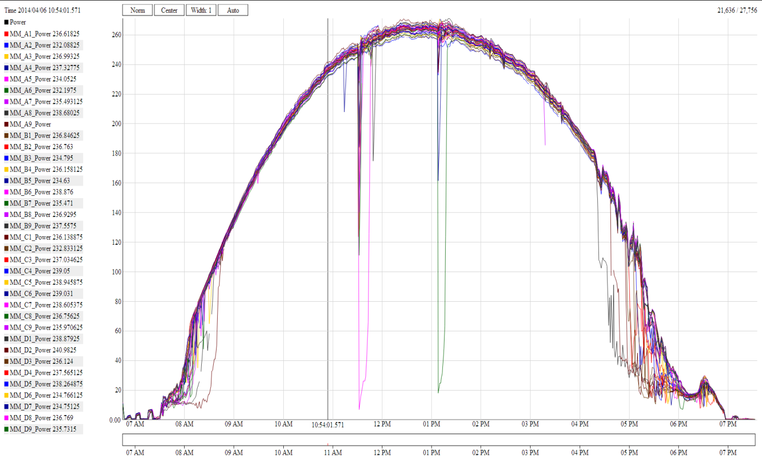
Commission Smart
Use Tigo Energy’s advanced tab to graph power, current, and voltage of each module for a selected time period

Slide 110
Commission Smart
Tigo Energy’s Web Interface provides you with:
Module Level Data
DC Voltage & Current
Production data
Analytical tools
System Notifications
Also available as iOS & Android Apps

Slide 111
Easier O&M
Identify and pinpoint system maintenance issues
System notifications
Production reports
Easier to make
decisions on when to
service a installation
Example
Hilton Suburban Solar Farm
Located in Victoria Australia
Tigo system open to the public online
Click here to see exactly how

Slide 112
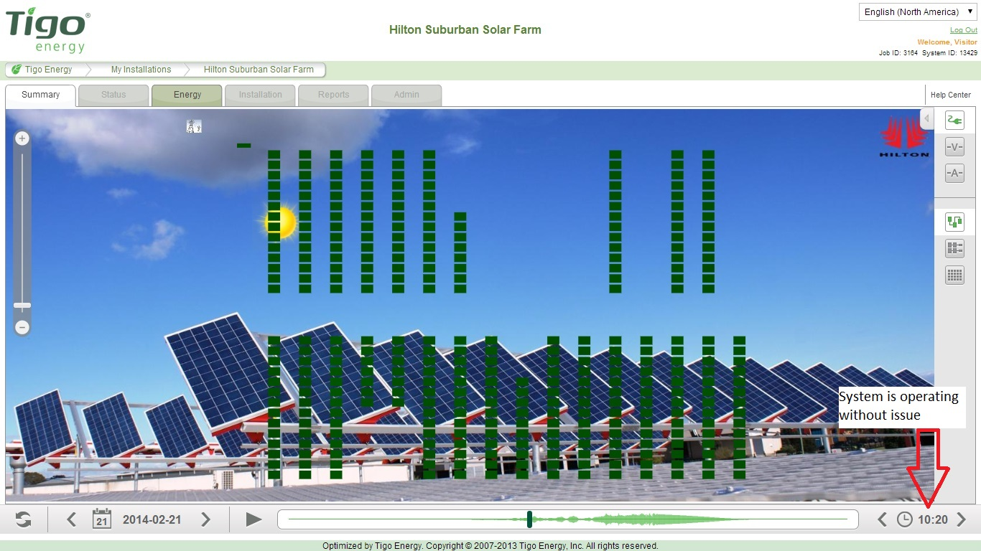
Operations & Maintenance

Slide 113
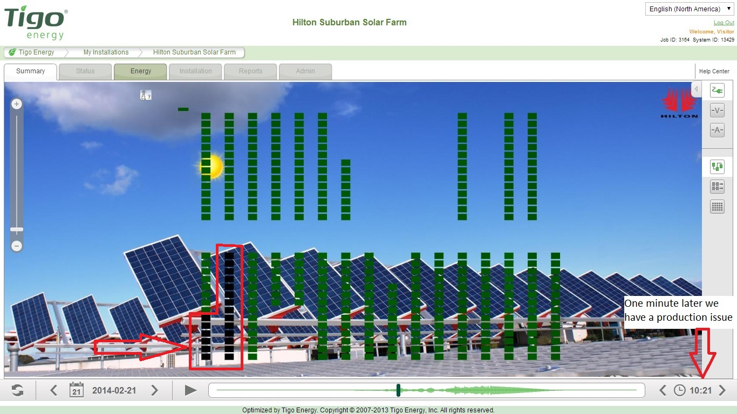
Operations & Maintenance

Slide 114
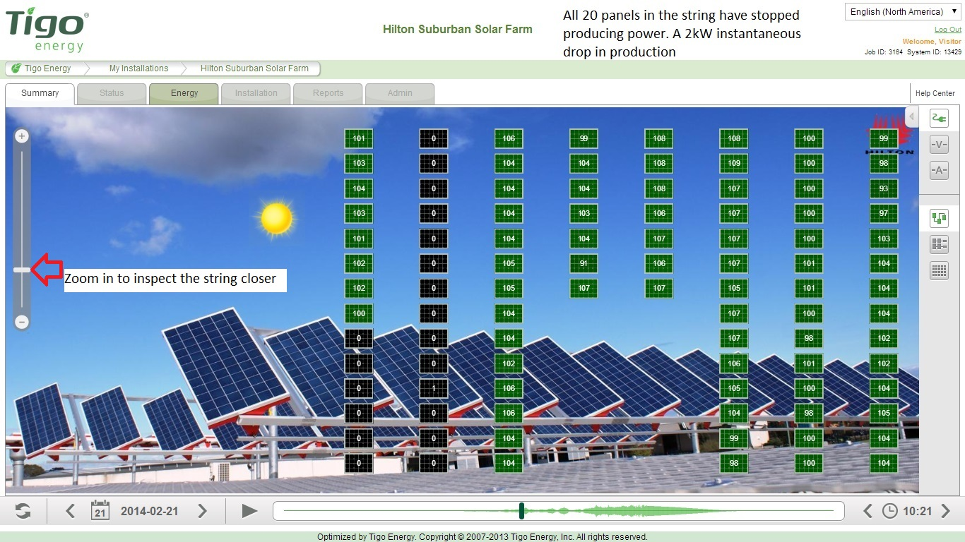
Operations & Maintenance

Slide 115
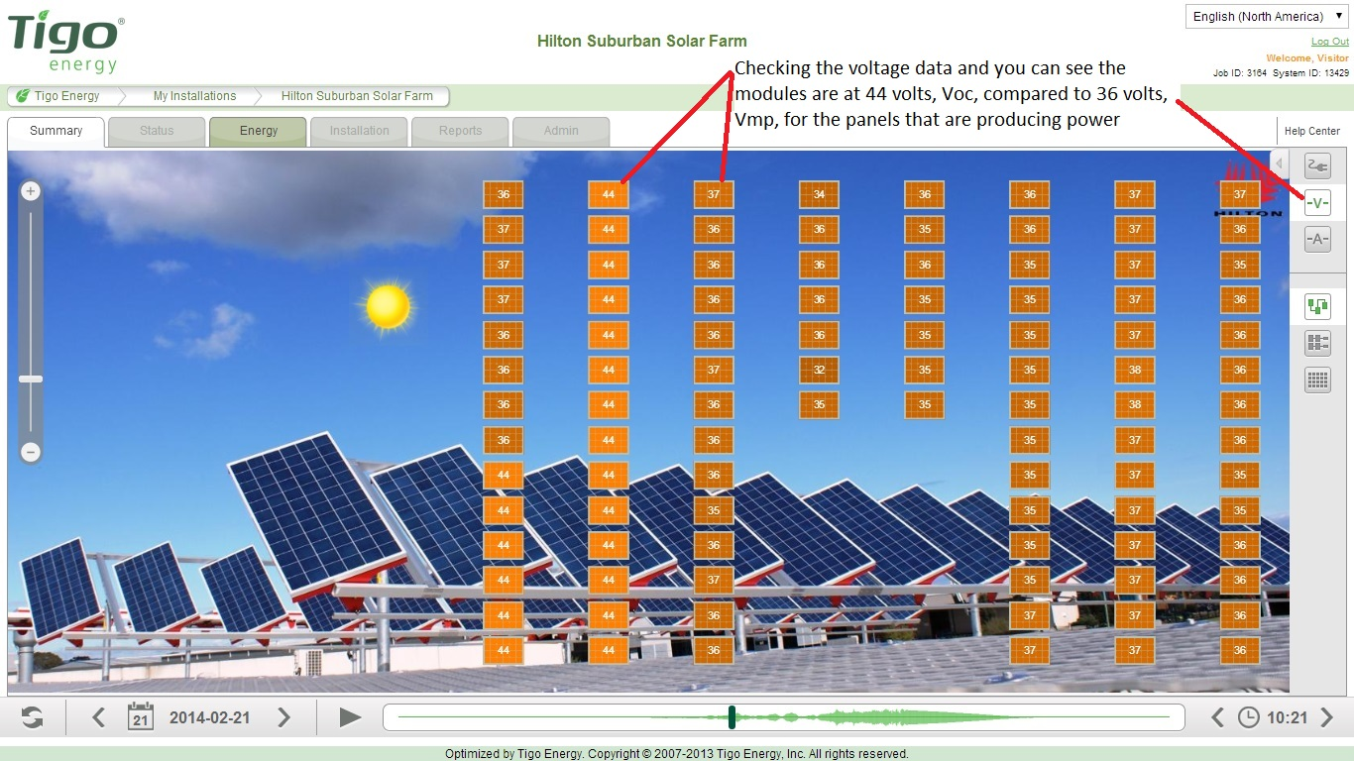
Operations & Maintenance

Slide 116
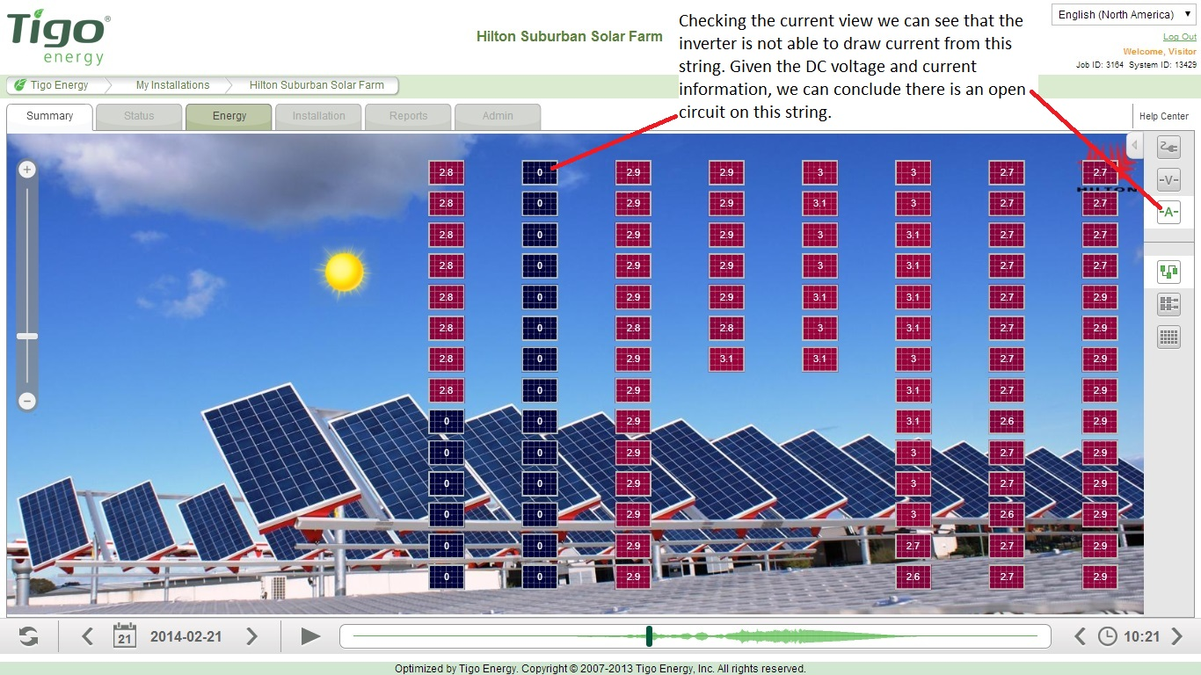
Operations & Maintenance

Slide 117
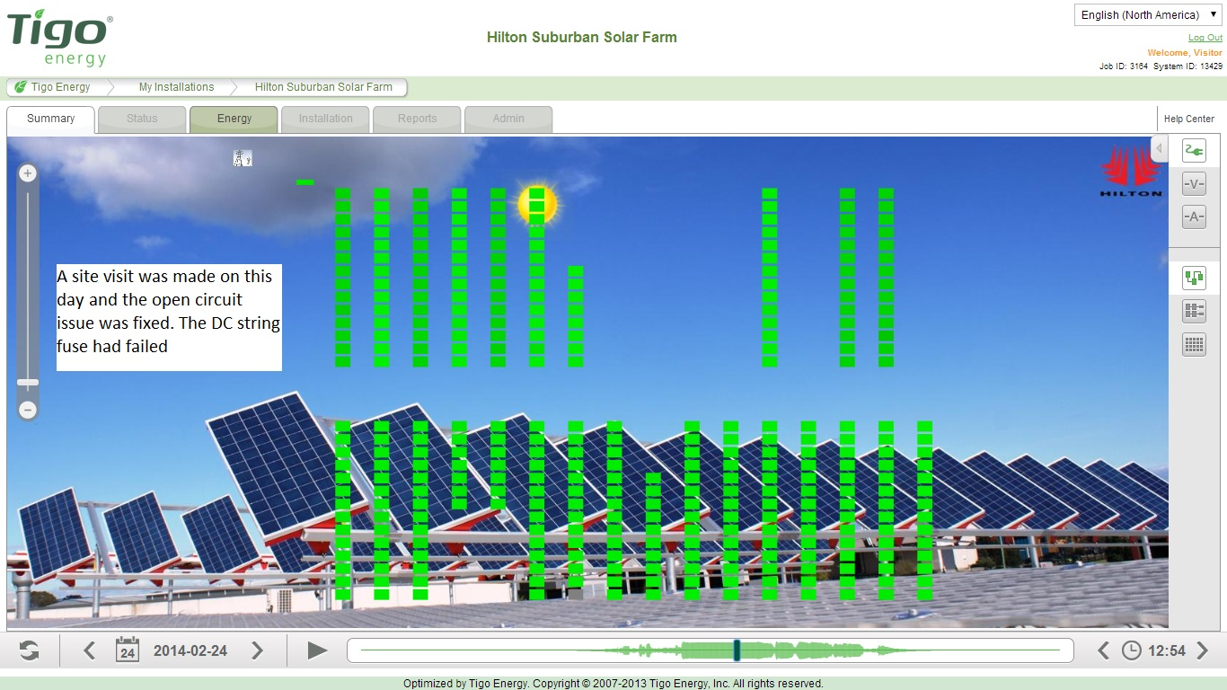
Operations & Maintenance
Commissioning process

Slide 118
Agenda
Solution Overview
Essential Steps
System design
System installation
Online system configuration
Commissioning process & Smart Asset Management overview
Summary
Notes:
This presentation has 4 chapters, each can be presented individually as it’s own presentation.

Slide 119
Agenda
Solution Overview
Essential Steps
System design
System installation
Online system configuration
Commissioning process & Smart Asset Management overview
Summary
Notes:
This presentation has 4 chapters, each can be presented individually as it’s own presentation.

Slide 120
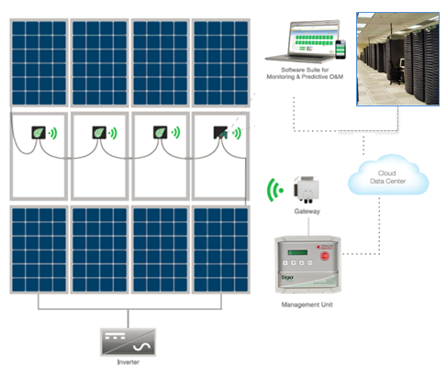
Tigo System
Embedded in the junction box of the module, same form-factor as normal
Works with ANY inverter
Management Unit used to interface with the units, activate safety, send data to the datacenter

Slide 121
Design Summary
Smart Modules are connected like standard PV modules
Each Gateway handles:
120 modules
50ft (15m) radius minus obstacles
Each MMU handles:
360 modules
Up to 7 Gateways

Slide 122
Keys to Success
Proper Gateway location
Smart Modules barcodes recorded and assigned to their actual physical location
Internet connection

Slide 123
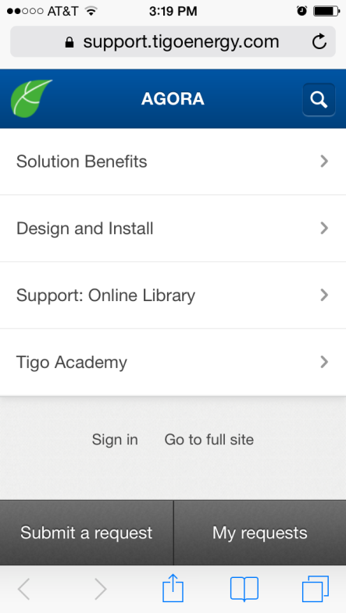
Discover Using a World of Resources
Available for you and your customers anytime and everywhere
Support.tigoenergy.com

Slide 124
And Provide Your Customers with Product Training
In person at the Tigo training facility
Live via webinars
On-demand at the Tigo Academy
Certified for redeeming NABCEP Continuing Education Credits

Slide 125
As Easy as 1 2 3
Thank You!

